Slide 1

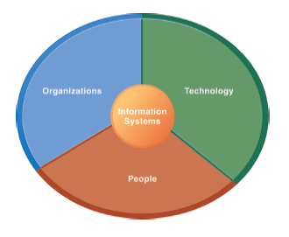
The Institute of Finance Management
ITU08117:
Information Systems Management
BAIT III
Mugyabuso, M. L
2022-2023
Notes:
There are two video cases and two instructional videos available for this chapter.

Slide 2
Understanding Information Systems: A Business Problem-Solving Approach
The Problem-Solving Approach

Slide 3
Understanding Information Systems: A Business Problem-Solving Approach
The Problem-Solving Approach
Few business problems are simple or straightforward.
Most business problems involve a number of major factors that can fall into three main categories:
Organization
Technology
People
Notes:
Ask students to think about the jobs they have held in the past, and then describe some of the common business problems they faced, the factors involved, and what category these factors fall into.

Slide 4
Understanding Information Systems: A Business Problem-Solving Approach
A Model of the Problem-Solving Process
Problem solving: four-step process
Problem identification
Solution design
Choice
Implementation

Slide 5
Understanding Information Systems: A Business Problem-Solving Approach
A Model of the Problem-Solving Process
Problem identification includes:
Agreement that problem exists
Definition of problem
Causes of problem
What can be done given resources of firm
Notes:
Ask students about their job experiences with problem identification. Usually, there are different points of view about what the problem actually is. There often is no agreement on the problem.

Slide 6
Understanding Information Systems: A Business Problem-Solving Approach
A Model of the Problem-Solving Process
Typical organizational problems
Outdated business processes
Unsupported culture and attitudes
Political in-fighting
Turbulent business environment, change
Complexity of task
Inadequate resources
Notes:
Ask students to describe if any of these typical business problems arose in their work experience.

Slide 7
Understanding Information Systems: A Business Problem-Solving Approach
A Model of the Problem-Solving Process
Typical technology problems
Insufficient or aging hardware
Outdated software
Inadequate database capacity
Insufficient telecommunications capacity
Incompatibility of old systems with new technology
Rapid technological change
Notes:
Once again, draw students out and ask them to speak about the technology problems they have experienced in their work.

Slide 8
Understanding Information Systems: A Business Problem-Solving Approach
A Model of the Problem-Solving Process
Typical people problems
Lack of employee training
Difficulties of evaluating performance
Legal and regulatory compliance
Work environment, ergonomics
Poor or indecisive management
Lack of employee support and participation

Slide 9
Understanding Information Systems: A Business Problem-Solving Approach
A Model of the Problem-Solving Process
Solution design
Often many possible solutions
Consider as many as possible to understand range of solutions
Choice: Factors include
Cost
Feasibility given resources and skills
Length of time needed to implement solution
Notes:
Why are there so many solutions to a problem? How many solutions can be seriously examined and explored?
Why should implementation be considered in the problem solving process? One reason is that you want to avoid solutions that cannot be easily implemented.

Slide 10
Understanding Information Systems: A Business Problem-Solving Approach
A Model of the Problem-Solving Process
Implementation
Building or purchasing solution
Testing solution, employee training
Change management
Measurement of outcomes
Feedback, evaluation of solution
Problem solving is a continuous process, not a single event
Sometimes chosen solution doesn’t work or needs adjustment
Notes:
Why aren’t problems solved once and for all? Some problems might be “solved” and forgotten, and lack of attention leads to the problems arising again.

Slide 11
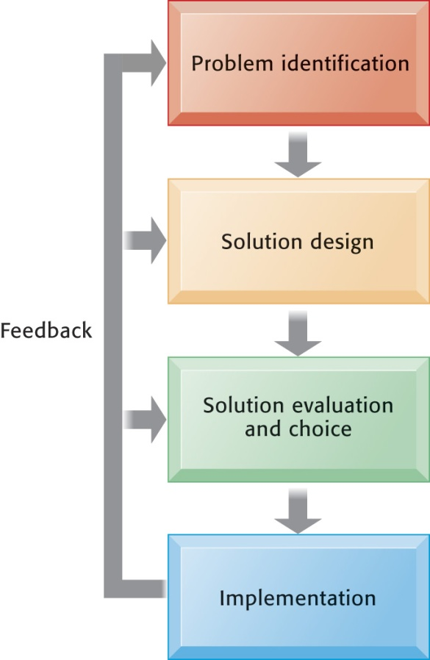
Understanding Information Systems: A Business Problem-Solving Approach
Problem Solving Is a Continuous Four-Step Process
During implementation and thereafter, the outcome must be continually measured and the information about how well the solution is working is fed back to the problem solvers. In this way, the identification of the problem can change over time, solutions can be changed, and new choices made, all based on experience.
Figure 1-4
Notes:
What makes problem solving continuous is that most solutions don’t always work perfectly and need fine tuning. Some decisions result in actions that don’t work at all, or work perfectly (at least for a period of time). In any case, you need continuous feedback from the environment to track how well solutions are working.

Slide 12
Understanding Information Systems: A Business Problem-Solving Approach
The Role of Critical Thinking in Problem Solving
Without critical thinking, easy to jump to conclusions, misjudge a problem, and waste resources
Critical thinking:
Sustained suspension of judgment with an awareness of multiple perspectives and alternatives

Slide 13
Understanding Information Systems: A Business Problem-Solving Approach
The Role of Critical Thinking in Problem Solving
Critical thinking:
is the intellectually disciplined process of actively and skillfully conceptualizing, applying, analyzing, synthesizing, and/or evaluating information gathered from, or generated by, observation, experience, reflection, reasoning, or communication, as a guide to belief and action.

Slide 14
Understanding Information Systems: A Business Problem-Solving Approach
The Role of Critical Thinking in Problem Solving
Four elements of critical thinking:
Maintaining doubt and suspending judgment
Being aware of different perspectives
Including technology, organization, and people perspectives
Testing alternatives and letting experience guide
Being aware of organizational and personal limitations
Notes:
Why should these elements of critical thinking be an issue at all? Why should it be hard to suspend judgment? Be aware of different perspectives? Test alternatives? Be aware of limitations?

Slide 15
Understanding Information Systems: A Business Problem-Solving Approach
The Connection Between Business Objectives, Problems, and Solutions
When firms cannot achieve business objectives these objectives become challenges.
Information systems often present solutions, partially or fully, to these challenges.
Notes:
If your objective is to increase sales of a new line of clothing, and then sales don’t increase, at the very least a business has a challenge (if not an outright “problem” that needs solving).

Slide 16
Information Systems and Your Career
Success in today’s job market requires a broad set of skills.
Job candidates must have problem-solving skills as well as technical skills so that they can complete specific tasks.
The service sector will account for 95 percent of the new jobs that are created or open up by 2019
Notes:
Just having one set of skills is not a very wise idea when preparing for future labor markets. The more skills you have (say English language skills or any language skills plus information systems skills plus some finance skills) the greater your attractiveness to future employers who may see you as a multi-skilled person who could fit into a variety of jobs.

Slide 17
Information Systems and Your Career
How Information Systems Will Affect Business Careers
Accounting:
Accountants increasingly rely on information systems to summarize transactions, create financial records, organize data, and perform financial analysis.
Skills:
Knowledge of databases and networks
Online financial transactions and reporting systems
How systems are used to achieve accounting functions

Slide 18
Information Systems and Your Career
How Information Systems Will Affect Business Careers
Finance:
Relationship between information systems and financial management and services is so strong that many advise finance majors to co-major in information systems.
Skills:
Use systems for financial reporting, direct investment activities, implement cash management strategies
Plan, organize, implement information systems strategies for the firm

Slide 19
Information Systems and Your Career
How Information Systems Will Affect Business Careers
Marketing:
No field has undergone more technology-driven change in the past five years than marketing and advertising.
Skills:
Work with databases for tracking and reporting on customer behavior, product performance, customer feedback, product development
Enterprise systems for product management, sales force management, customer relationship management

Slide 20
Information Systems and Your Career
How Information Systems Will Affect Business Careers
Operations management in services and manufacturing:
Production managers, administrative service managers, and operations analysts
Skills:
Hardware and software platforms for operations management
Use database and analytical software for coordinating and optimizing resources required for producing goods and services

Slide 21
Information Systems and Your Career
How Information Systems Will Affect Business Careers
Management:
The job of management has been transformed by information systems.
Impossible to manage business today without information systems.
Skills:
Use of information systems for each function of job, from desktop productivity tools to applications coordinating the entire enterprise

Slide 22

Information Systems and Your Career
The job of management
requires extensive use of information systems to support decision making and to monitor the performance of the firm.

Slide 23
Information Systems and Your Career
How Information Systems Will Affect Business Careers
Information systems:
Fast changing and dynamic profession because information technologies are among most important tools for achieving business firms’ key objectives
Domestic and offshore outsourcing
Skills:
Uses of new and emerging hardware and software to achieve six business objectives
An ability to take a leadership role in the design and implementation of new information systems

Slide 24
Information Systems and Your Career
How Information Systems Will Affect Business Careers
Common requirements
How IT helps achieve six business objectives
Central role of databases
Business analytics and intelligence systems
Working with specialists and systems designers
Ethical, social, legal environment and issues
Use of IT to meet legal requirements
Notes:
All of the occupational areas discussed in this section require some level of information systems skills and knowledge. IS is a major lever of organizational change in the future, and very important for achieving new levels of productivity. The future will be very rich in digital information. Learning how to make sense out it will be a very valuable skill.

Slide 25
NEXT
Business Environment and Role of Information Systems in Business
Components of Business
Types of Information Systems
Collaboration and Teamwork

